Slide 1
Linear Regression
Marlabs

Slide 2
Table of Content
What is Linear Regression?
Linear Regression Assumptions
The line of the best fit
Calculate Error
The Cost Function
Gradient Descent
Model Evaluation
Bias & Variance
Regularization
Polynomial Regression

Slide 3
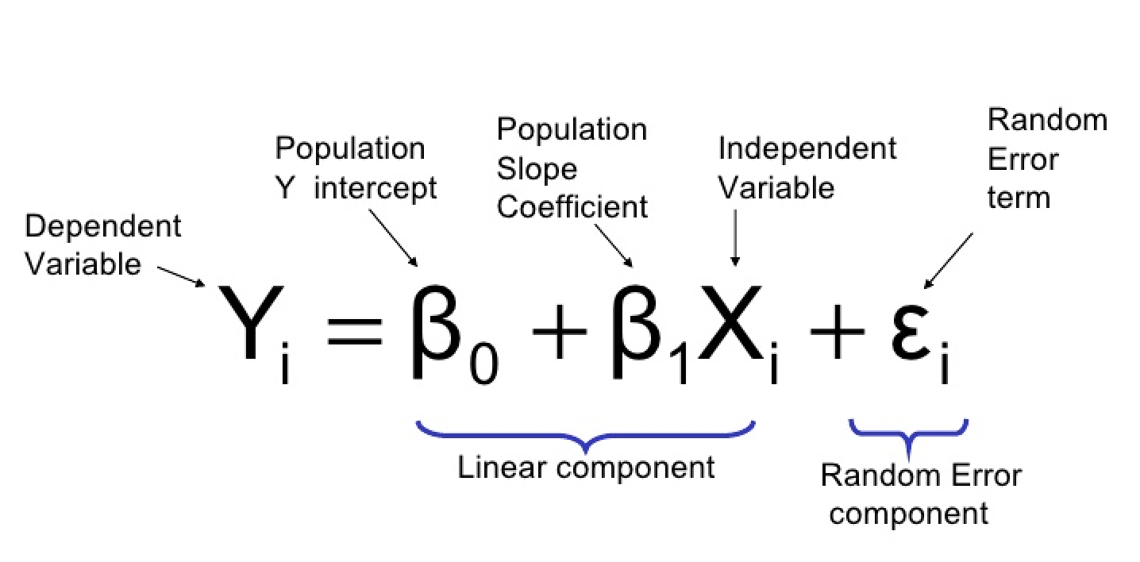
What is Linear Regression?
Linear regression is the simplest and most widely used statistical technique for predictive modeling.
It basically gives us an equation, where we have our features as independent variables, on which our target variable is dependent upon.

Slide 4
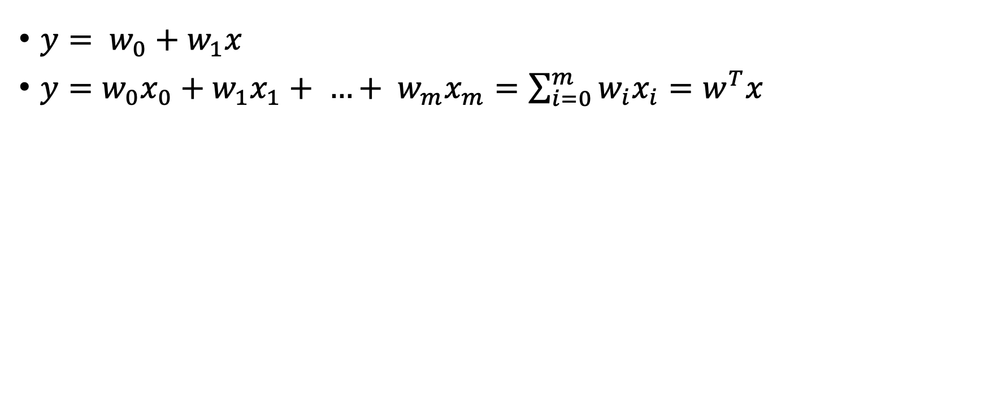
Simple Linear Regression & Multiple Linear Regression
$y= w_{0}+w_{1}x$
$y=w_{0}x_{0}+w_{1}x_{1}+ …+ w_{m}x_{m}=\sum_{i=0}^{m}{w_{i}x_{i}=w^{T}x}$

Slide 5
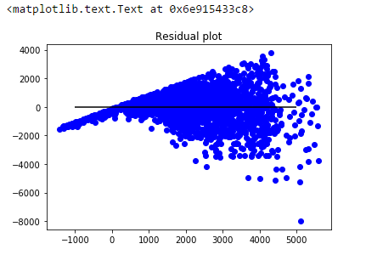
Linear Regression Assumptions
Linear relationship (scatter plot).
Multivariate normality (histogram or a Q-Q-Plot, non-linear transformation).
No or little multicollinearity(Correlation matrix).
No autocorrelation.
Autocorrelation occurs when the residuals are not independent from each other.(scatter plot)
Homoscedasticity(meaning “same variance”
Residual Plots).

Slide 6
The Line of Best Fit

Slide 7
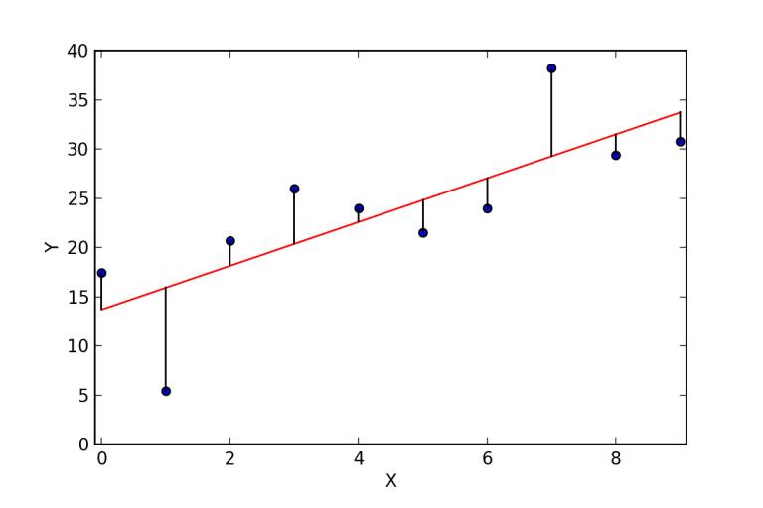
The Line of Best Fit
The main purpose of the best fit line is that our predicted values should be closer to our actual or the observed values, because there is no point in predicting values which are far away from the real values.
The residuals are indicated by the vertical lines showing the difference between the predicted and actual value.

Slide 8
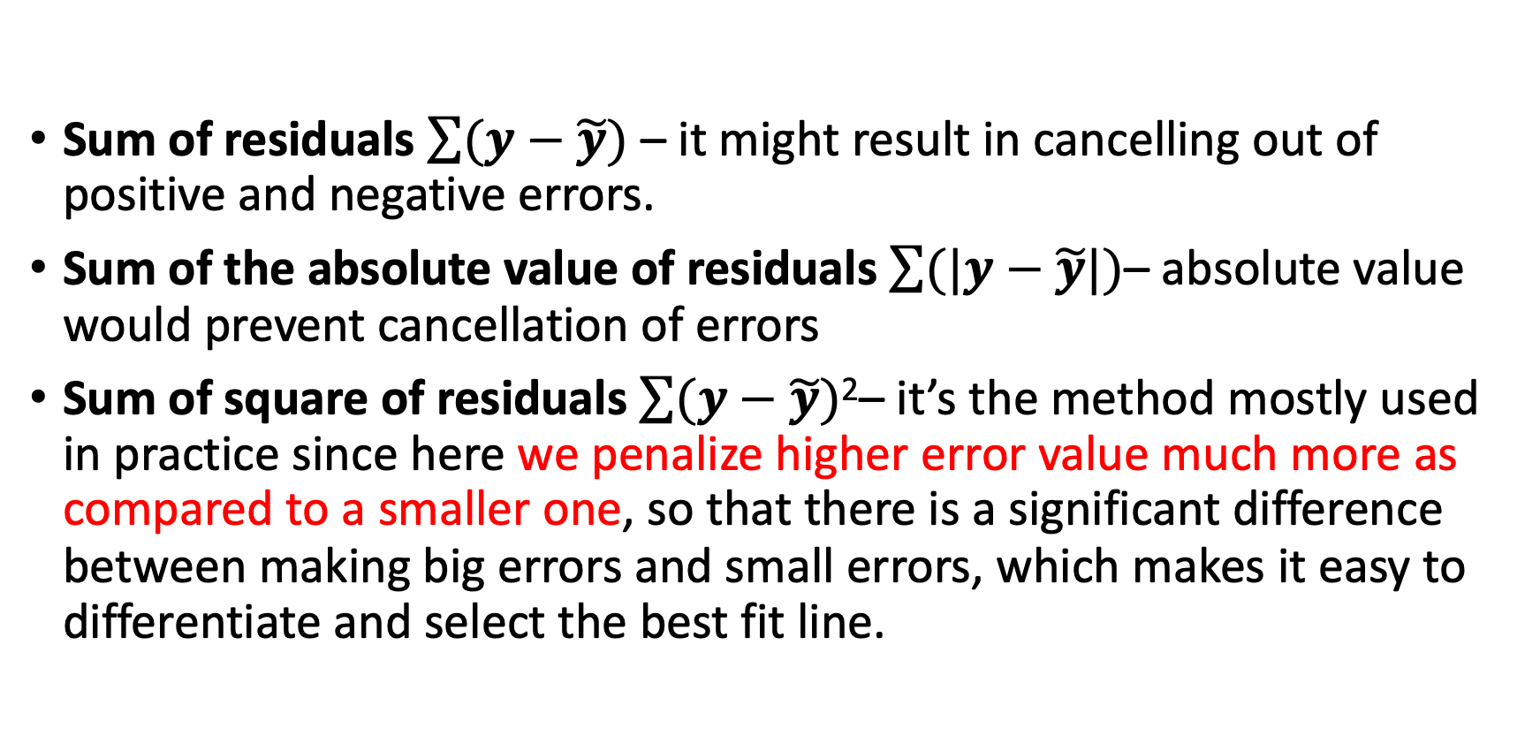
Calculate Error
Sum of residuals $\sum{(y−\tilde{y})}$ – it might result in cancelling out of positive and negative errors.
Sum of the absolute value of residuals $\sum{(|y−\tilde{y}|)}$– absolute value would prevent cancellation of errors
Sum of square of residuals $\sum{(y−\tilde{y})\text{2}}$– it’s the method mostly used in practice since here we penalize higher error value much more as compared to a smaller one, so that there is a significant difference between making big errors and small errors, which makes it easy to differentiate and select the best fit line.

Slide 9
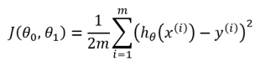
The Cost Function
It is basically used to define and measure the error of the model.
Find the minimum value of this equation (Ordinal Least Square Error, OLS)
Gradient descent works in a similar manner. It iteratively updates Θ, to find a point where the cost function would be minimum.

Slide 10
Gradient Descent For Machine Learning
Gradient descent is an optimization algorithm used to find the values of parameters (coefficients) of a function (f) that minimizes a cost function (cost).
Gradient descent is best used when the parameters cannot be calculated analytically (e.g. using linear algebra) and must be searched.
The goal is to continue to try different values for the coefficients, evaluate their cost and select new coefficients that have a slightly better (lower) cost.

Slide 11
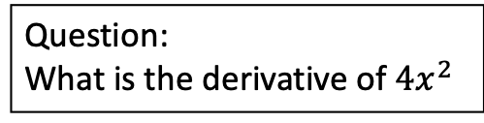
Gradient Descent Procedure
The procedure starts off with initial values for the coefficient or coefficients for the function. These could be 0.0 or a small random value. coefficient = 0.0
The cost of the coefficients is evaluated by plugging them into the function and calculating the cost.
cost = f(coefficient) cost = evaluate(f(coefficient))
The derivative of the cost is calculated. delta = derivative(cost)
Now that we know from the derivative which direction is downhill, we can now update the coefficient values.
A learning rate parameter (alpha) must be specified that controls how much the coefficients can change on each update. coefficient = coefficient − (alpha × delta)
Delta is the error for the model on the training data attributed to the weight.
This process is repeated until the cost of the coefficients (cost) is 0.0 or no further improvements in cost can be achieved.
Question:
What is the derivative of $4x^{2}$

Slide 12
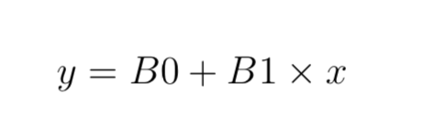
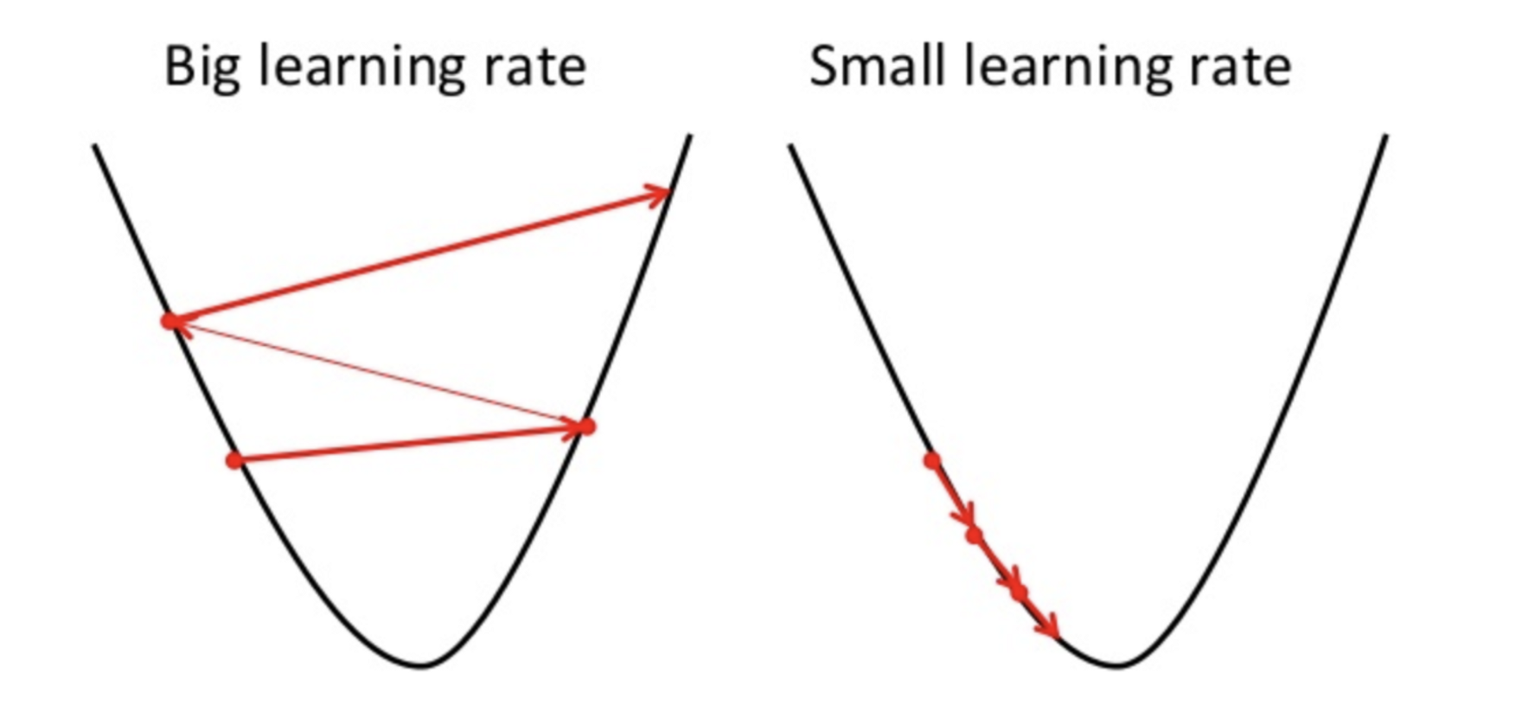
Simple Linear Regression Gradient Descent
x | y
1 | 1
2 | 3
4 | 3
3 | 2
5 | 5
Excel Exercise: simple linear regression with gradient descent.

Slide 13
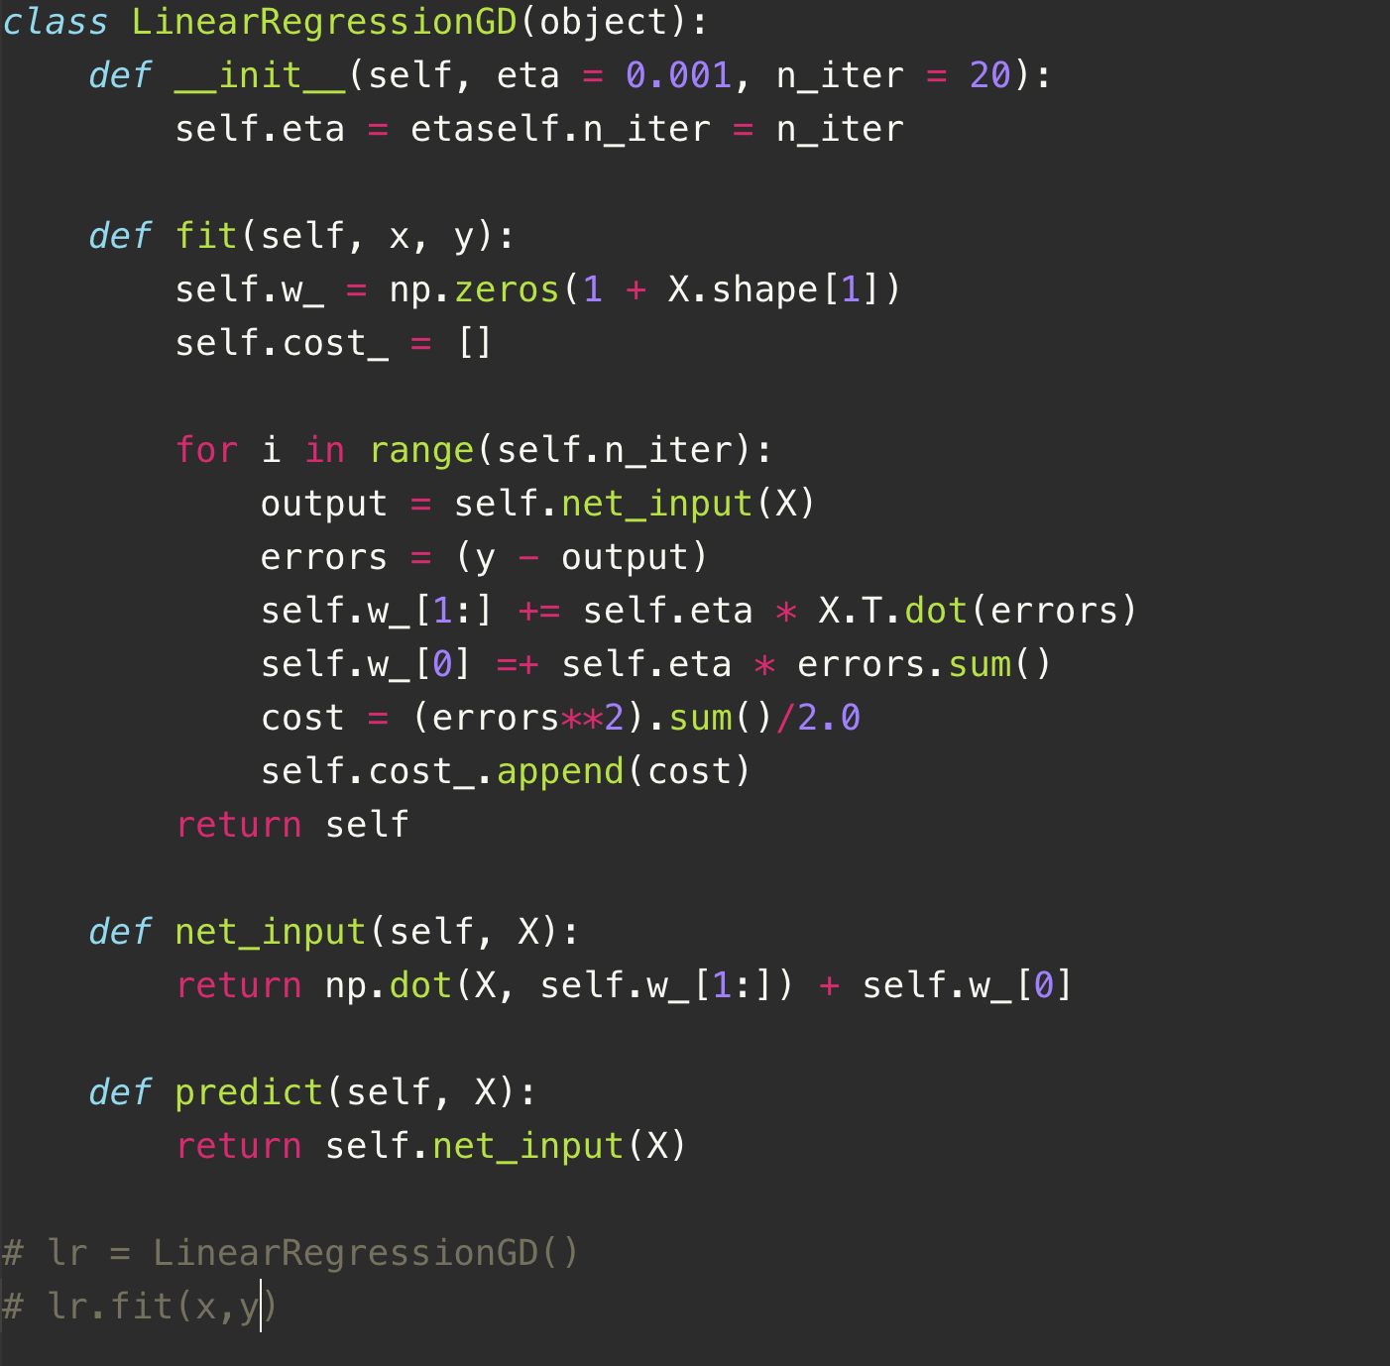
Simple Linear Regression Gradient Descent (Python Code)

Slide 14
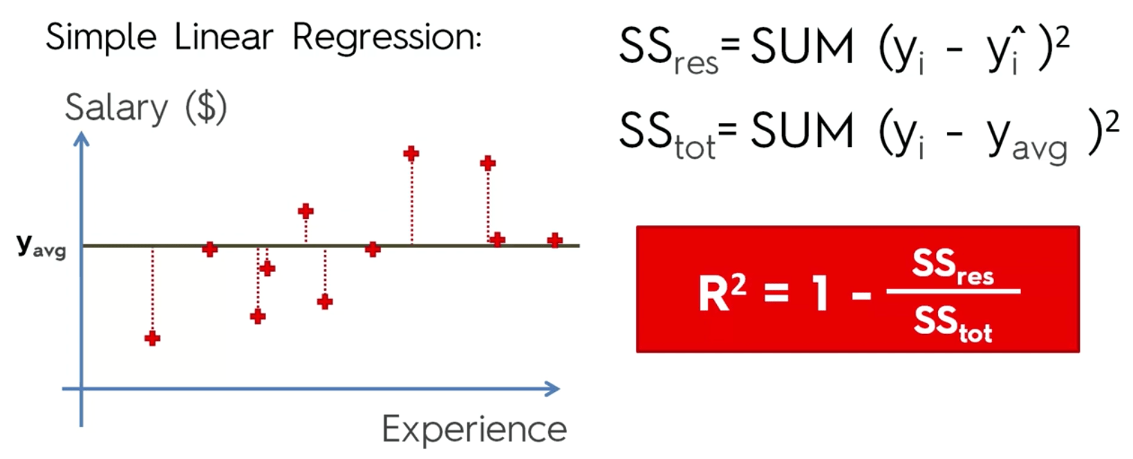
Model Evaluation- R-Squared & Adjusted R-Squared
R-Squared: It determines how much of the total variation in Y (dependent variable) is explained by the variation in X (independent variable). Mathematically, it can be written as:
The residual of an observed value is the difference between the observed value and the estimated value of the quantity of interest.
The value of R-squared most of time is between 0 and 1, where 0 means that the model does not explain any variability in the target variable (Y) and 1 meaning it explains full variability in the target variable.

Slide 15
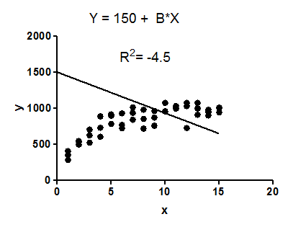
Model Evaluation- R-Squared & Adjusted R-Squared
𝑅² compares the fit of the chosen model with that of a horizontal straight line (the null hypothesis).
If the chosen model fits worse than a horizontal line, then 𝑅² is negative.
Note that 𝑅² is not always the square of anything, so it can have a negative value without violating any rules of math.
𝑅² is negative only when the chosen model does not follow the trend of the data, so fits worse than a horizontal line.
R-Squared is negative:

Slide 16
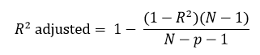
Model Evaluation- R-Squared & Adjusted R-Squared
Adjusted R-Squared
One of the drawbacks of R² is that if new predictors (X) are added to our model, R² only increases or remains constant but it never decreases.
The Adjusted R-Square is the modified form of R-Square that has been adjusted for the number of predictors in the model. It incorporates model’s degree of freedom. The adjusted R-Square only increases if the new term improves the model accuracy.
p = Number of predictors
N = total sample size

Slide 17
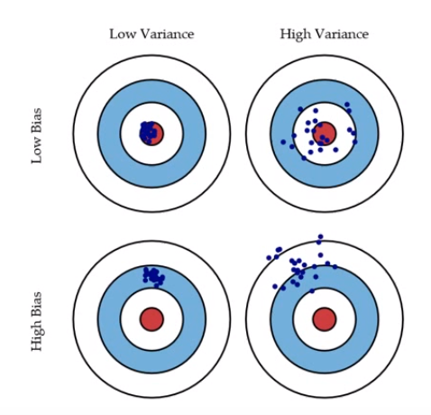
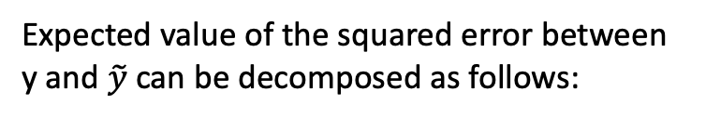
Bias & Variance in Regression Models
Expected value of the squared error between y and $\tilde{y}$ can be decomposed as follows:

Slide 18
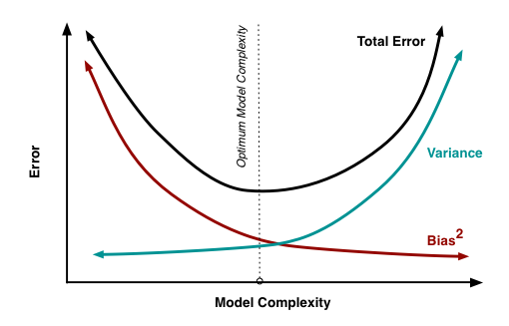
Bias & Variance
As we add more and more parameters to our model.(Overfitting) Its complexity increases, which results in increasing variance and decreasing bias. To overcome underfitting or high bias, we can basically add new parameters to our model so that the model complexity increases, and thus reducing high bias.

Slide 19
Overcome Overfitting for a Regression Model
Get more data
Reduce the model complexity
Regularization

Slide 20
Regularization
In regularization, what we do is normally we keep the same number of features, but reduce the magnitude of the coefficients.
Lasso Regression (LASSO: Least Absolute Shrinkage and Selection Operator)
Ridge Regression
Elastic Net

Slide 21
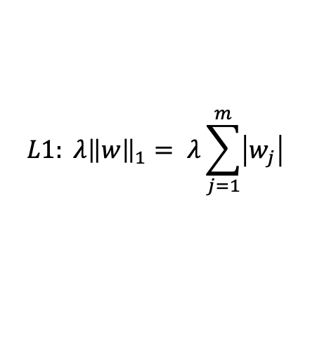
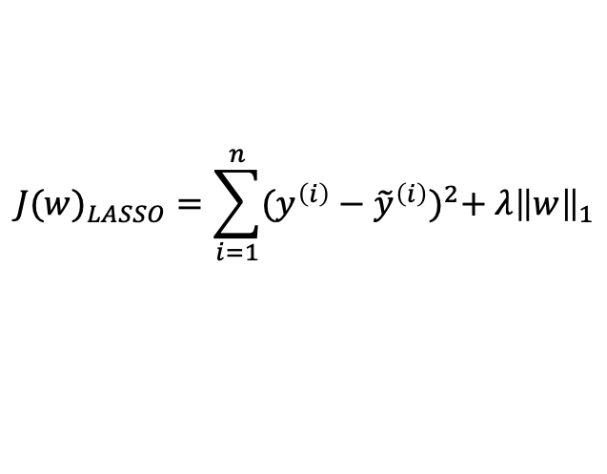
LASSO Regression (L1)
Depending on the regularization strength, certain weights can become zero, which also makes LASSO useful as a supervised feature selection technique.
$${J(w)}_{LASSO}=\sum_{i=1}^{n}{{(y^{\left(i\right)}−{\tilde{y}}^{\left(i\right)})}^{2}+ λ{\left\|w\right\|}_{1}}$$
$$L1: λ{\left\|w\right\|}_{1}= λ\sum_{j=1}^{m}{\left|w_{j}\right|}$$

Slide 22
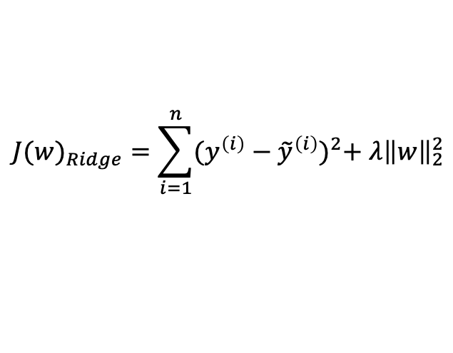
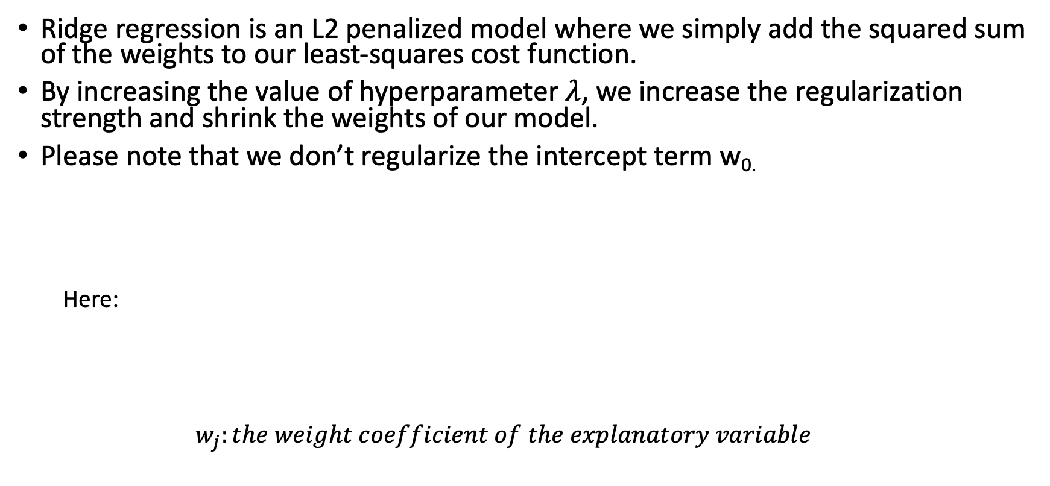
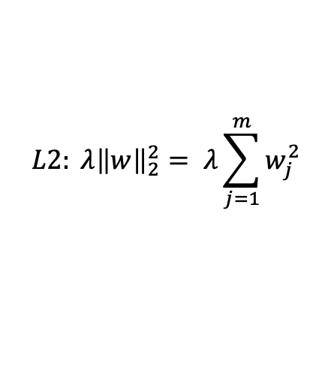
Ridge Regression (L2)
Ridge regression is an L2 penalized model where we simply add the squared sum of the weights to our least-squares cost function.
By increasing the value of hyperparameter $λ$, we increase the regularization strength and shrink the weights of our model.
Please note that we don’t regularize the intercept term w_{0.}
Here:
$$w_{j}:the weight coefficient of the explanatory variable$$
$${J(w)}_{Ridge}=\sum_{i=1}^{n}{{(y^{\left(i\right)}−{\tilde{y}}^{\left(i\right)})}^{2}+ λ{\left\|w\right\|}_{2}^{2}}$$
$$L2: λ{\left\|w\right\|}_{2}^{2}= λ\sum_{j=1}^{m}{w_{j}^{2}}$$

Slide 23
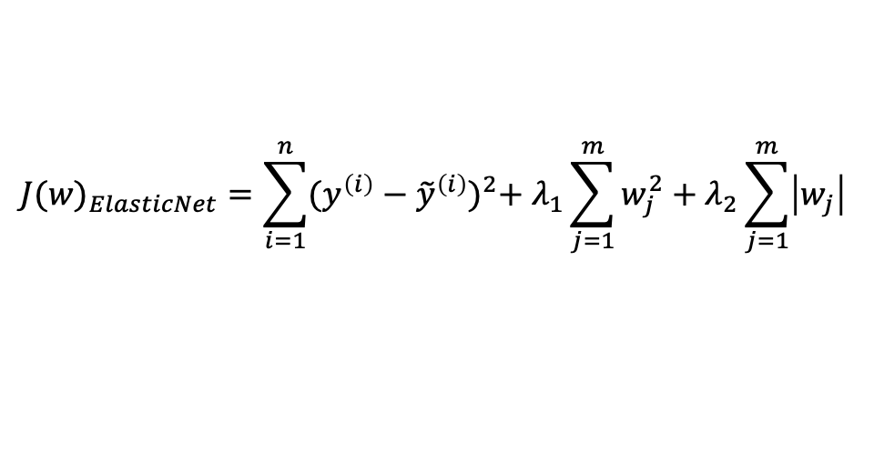
Elastic Net
A compromise between Ridge regression and LASSO is Elastic Net, which has an L1 penalty to generate sparsity and an L2 penalty to overcome some of the limitations of LASSO.
$${J(w)}_{ElasticNet}=\sum_{i=1}^{n}{{(y^{\left(i\right)}−{\tilde{y}}^{\left(i\right)})}^{2}+ λ_{1}\sum_{j=1}^{m}{w_{j}^{2}+λ_{2}\sum_{j=1}^{m}{\left|w_{j}\right|}}}$$

Slide 24
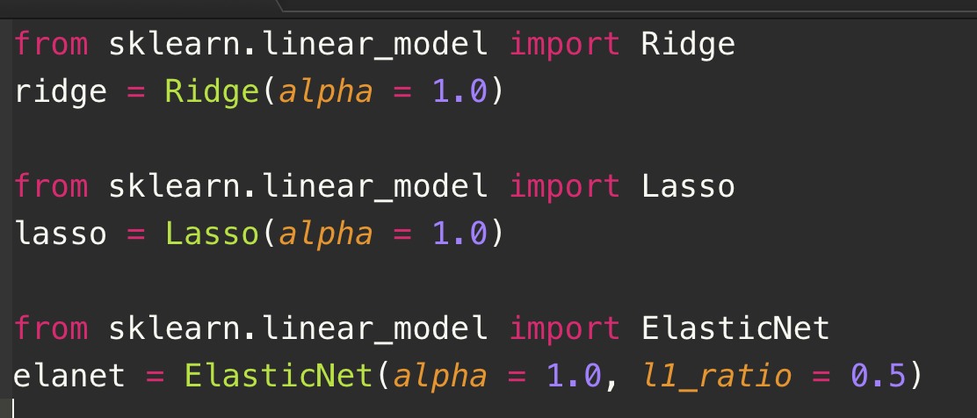
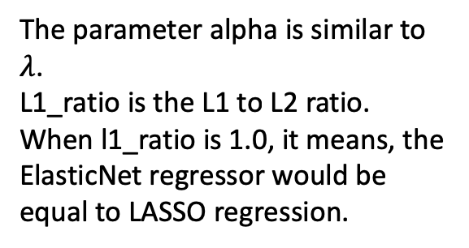
Python Code for LASSO, Ridge, Elastic Net
The parameter alpha is similar to $λ$.
L1_ratio is the L1 to L2 ratio.
When l1_ratio is 1.0, it means, the ElasticNet regressor would be equal to LASSO regression.

Slide 25
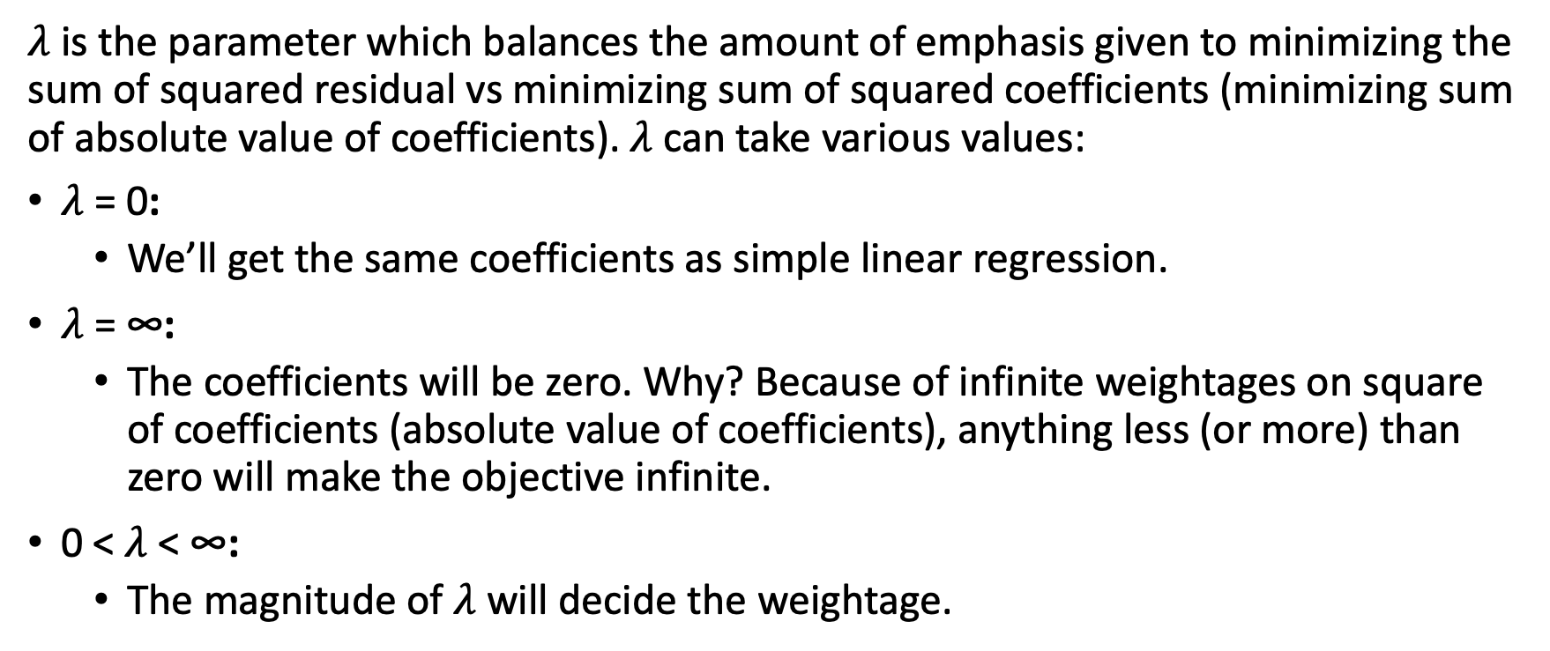
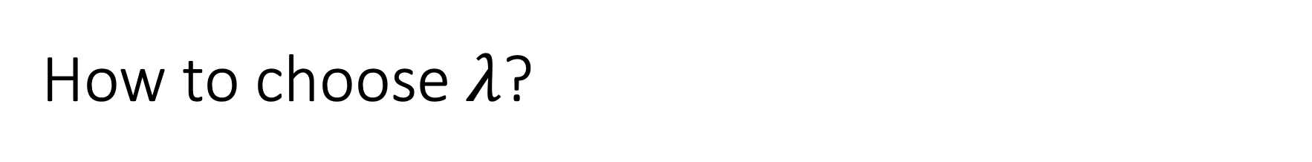
How to choose $λ$?
$λ$ is the parameter which balances the amount of emphasis given to minimizing the sum of squared residual vs minimizing sum of squared coefficients (minimizing sum of absolute value of coefficients). $λ$ can take various values:
$λ$ = 0:
We’ll get the same coefficients as simple linear regression.
$λ$ = ∞:
The coefficients will be zero. Why? Because of infinite weightages on square of coefficients (absolute value of coefficients), anything less (or more) than zero will make the objective infinite.
0 < $λ$ < ∞:
The magnitude of $λ$ will decide the weightage.

Slide 26
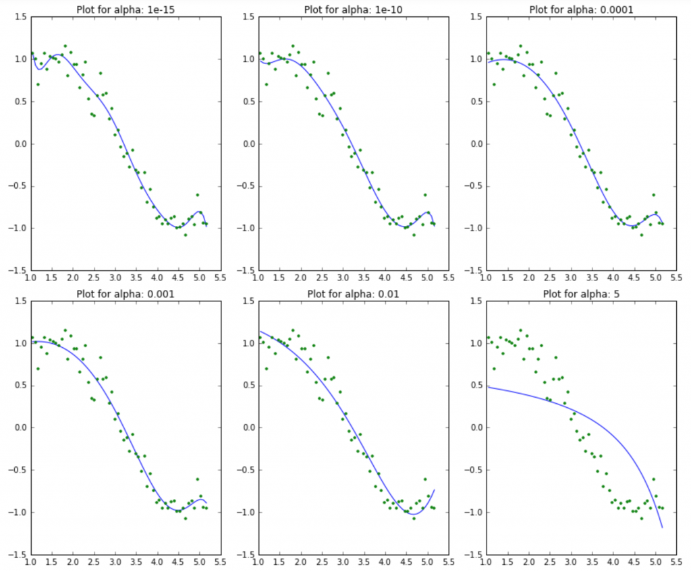
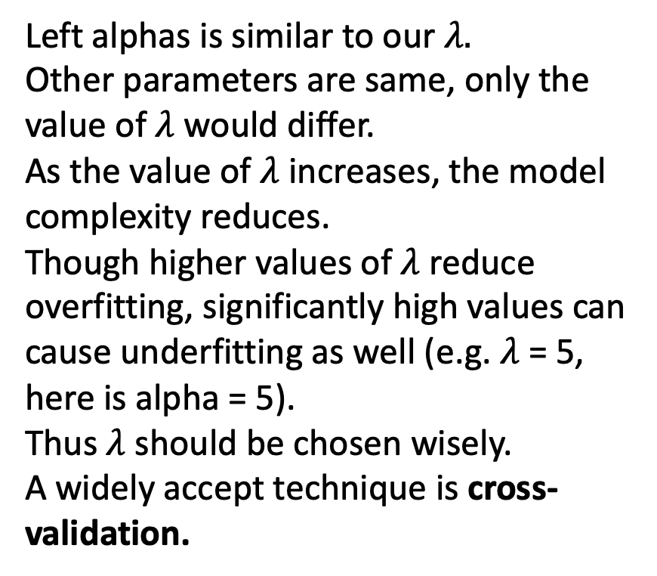
How to choose $λ$?
Left alphas is similar to our $λ.$
Other parameters are same, only the value of $λ$ would differ.
As the value of $λ$ increases, the model complexity reduces.
Though higher values of $λ$ reduce overfitting, significantly high values can cause underfitting as well (e.g. $λ$ = 5, here is alpha = 5).
Thus $λ$ should be chosen wisely.
A widely accept technique is cross-validation.

Slide 27
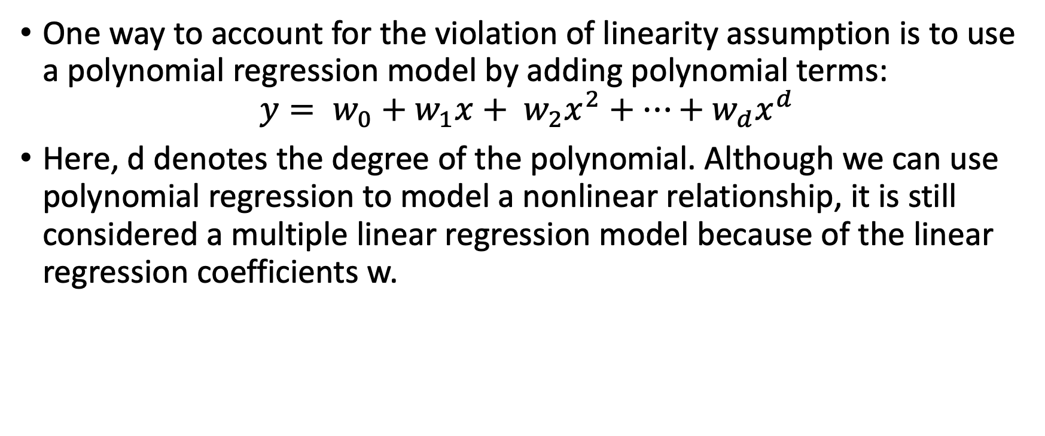
Polynomial Regression
One way to account for the violation of linearity assumption is to use a polynomial regression model by adding polynomial terms:
$$y= w_{0}+w_{1}x+ w_{2}x^{2}+…+w_{d}x^{d}$$
Here, d denotes the degree of the polynomial. Although we can use polynomial regression to model a nonlinear relationship, it is still considered a multiple linear regression model because of the linear regression coefficients w.

Slide 28
Linear Regression Related Interview Questions
1. True-False: It is possible to design a Linear regression algorithm using a neural network?
2. Which of the following methods do we use to find the best fit line for data in Linear Regression?
A) Least Square Error B) Maximum Likelihood C) Logarithmic Loss D) Both A and B
3. Which of the following evaluation metrics can be used to evaluate a model while modeling a continuous output variable?
A) AUC-ROC B) Accuracy C) Logloss D) Mean-Squared-Error

Slide 29
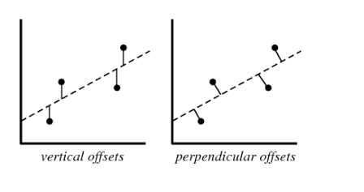
Linear Regression Related Interview Questions
4. Which of the following offsets, do we use in linear regression’s least square line fit? Suppose horizontal axis is independent variable and vertical axis is dependent variable.
A) Vertical offset B) Perpendicular offset C) Both, depending on the situation D) None of above

Slide 30
Answer
True. A Neural network can be used as a universal approximator, so it can definitely implement a linear regression algorithm.
A. In linear regression, we try to minimize the least square errors of the model to identify the line of best fit.
Since linear regression gives output as continuous values, so in such case we use mean squared error metric to evaluate the model performance. Remaining options are use in case of a classification problem.
A. We always consider residuals as vertical offsets. We calculate the direct differences between actual value and the Y labels. Perpendicular offset are useful in case of PCA.

